Slide 1
Community Rehabilitation Providers
CRP Application Process

Slide 2
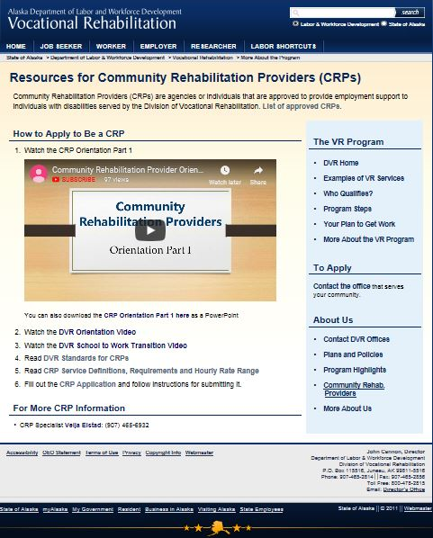
CRP Application Process
CRP Application on DVR’s Website:
http://www.labor.state.ak.us/dvr/

Slide 3
CRP Application Process 1
Complete and submit the CRP application & resume to DVR’s CRP Specialist.

Slide 4
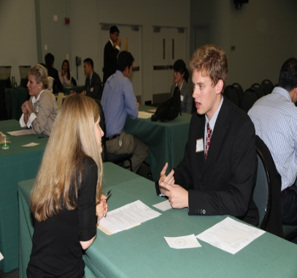
CRP Application Process 2
CRP Specialist will schedule an interview
Your Experience
Your Knowledge of the DVR Process
Services You Propose to Provide

Slide 5
CRP Application Process 3
Successful CRP Applicants will be scheduled for an interview with a local VR Manager
Describe & market your experience
Inquire about the services needed in their region

Slide 6
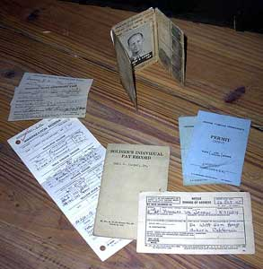
Time to Submit Documents
Successful CRP applicants will be instructed to purchase and submit documentation verifying:
Professional Liability Insurance Coverage
Business License
Criminal Background Clearance
Other Documents

Slide 7
After Submitting Documents
Review, Sign & Return CRP Agreement

Slide 8
Summary CRP Application Process
Complete & submit CRP Application- DVR’s Website: http://www.labor.state.ak.us/dvr/
Interview with CRP Specialist & local VR Manager
Purchase & submit proof of insurance, business license, background checks, etc., to CRP Specialist
Review, sign and return CRP Agreement

Slide 9
CRP Application Process
Complete!

