Slide 1
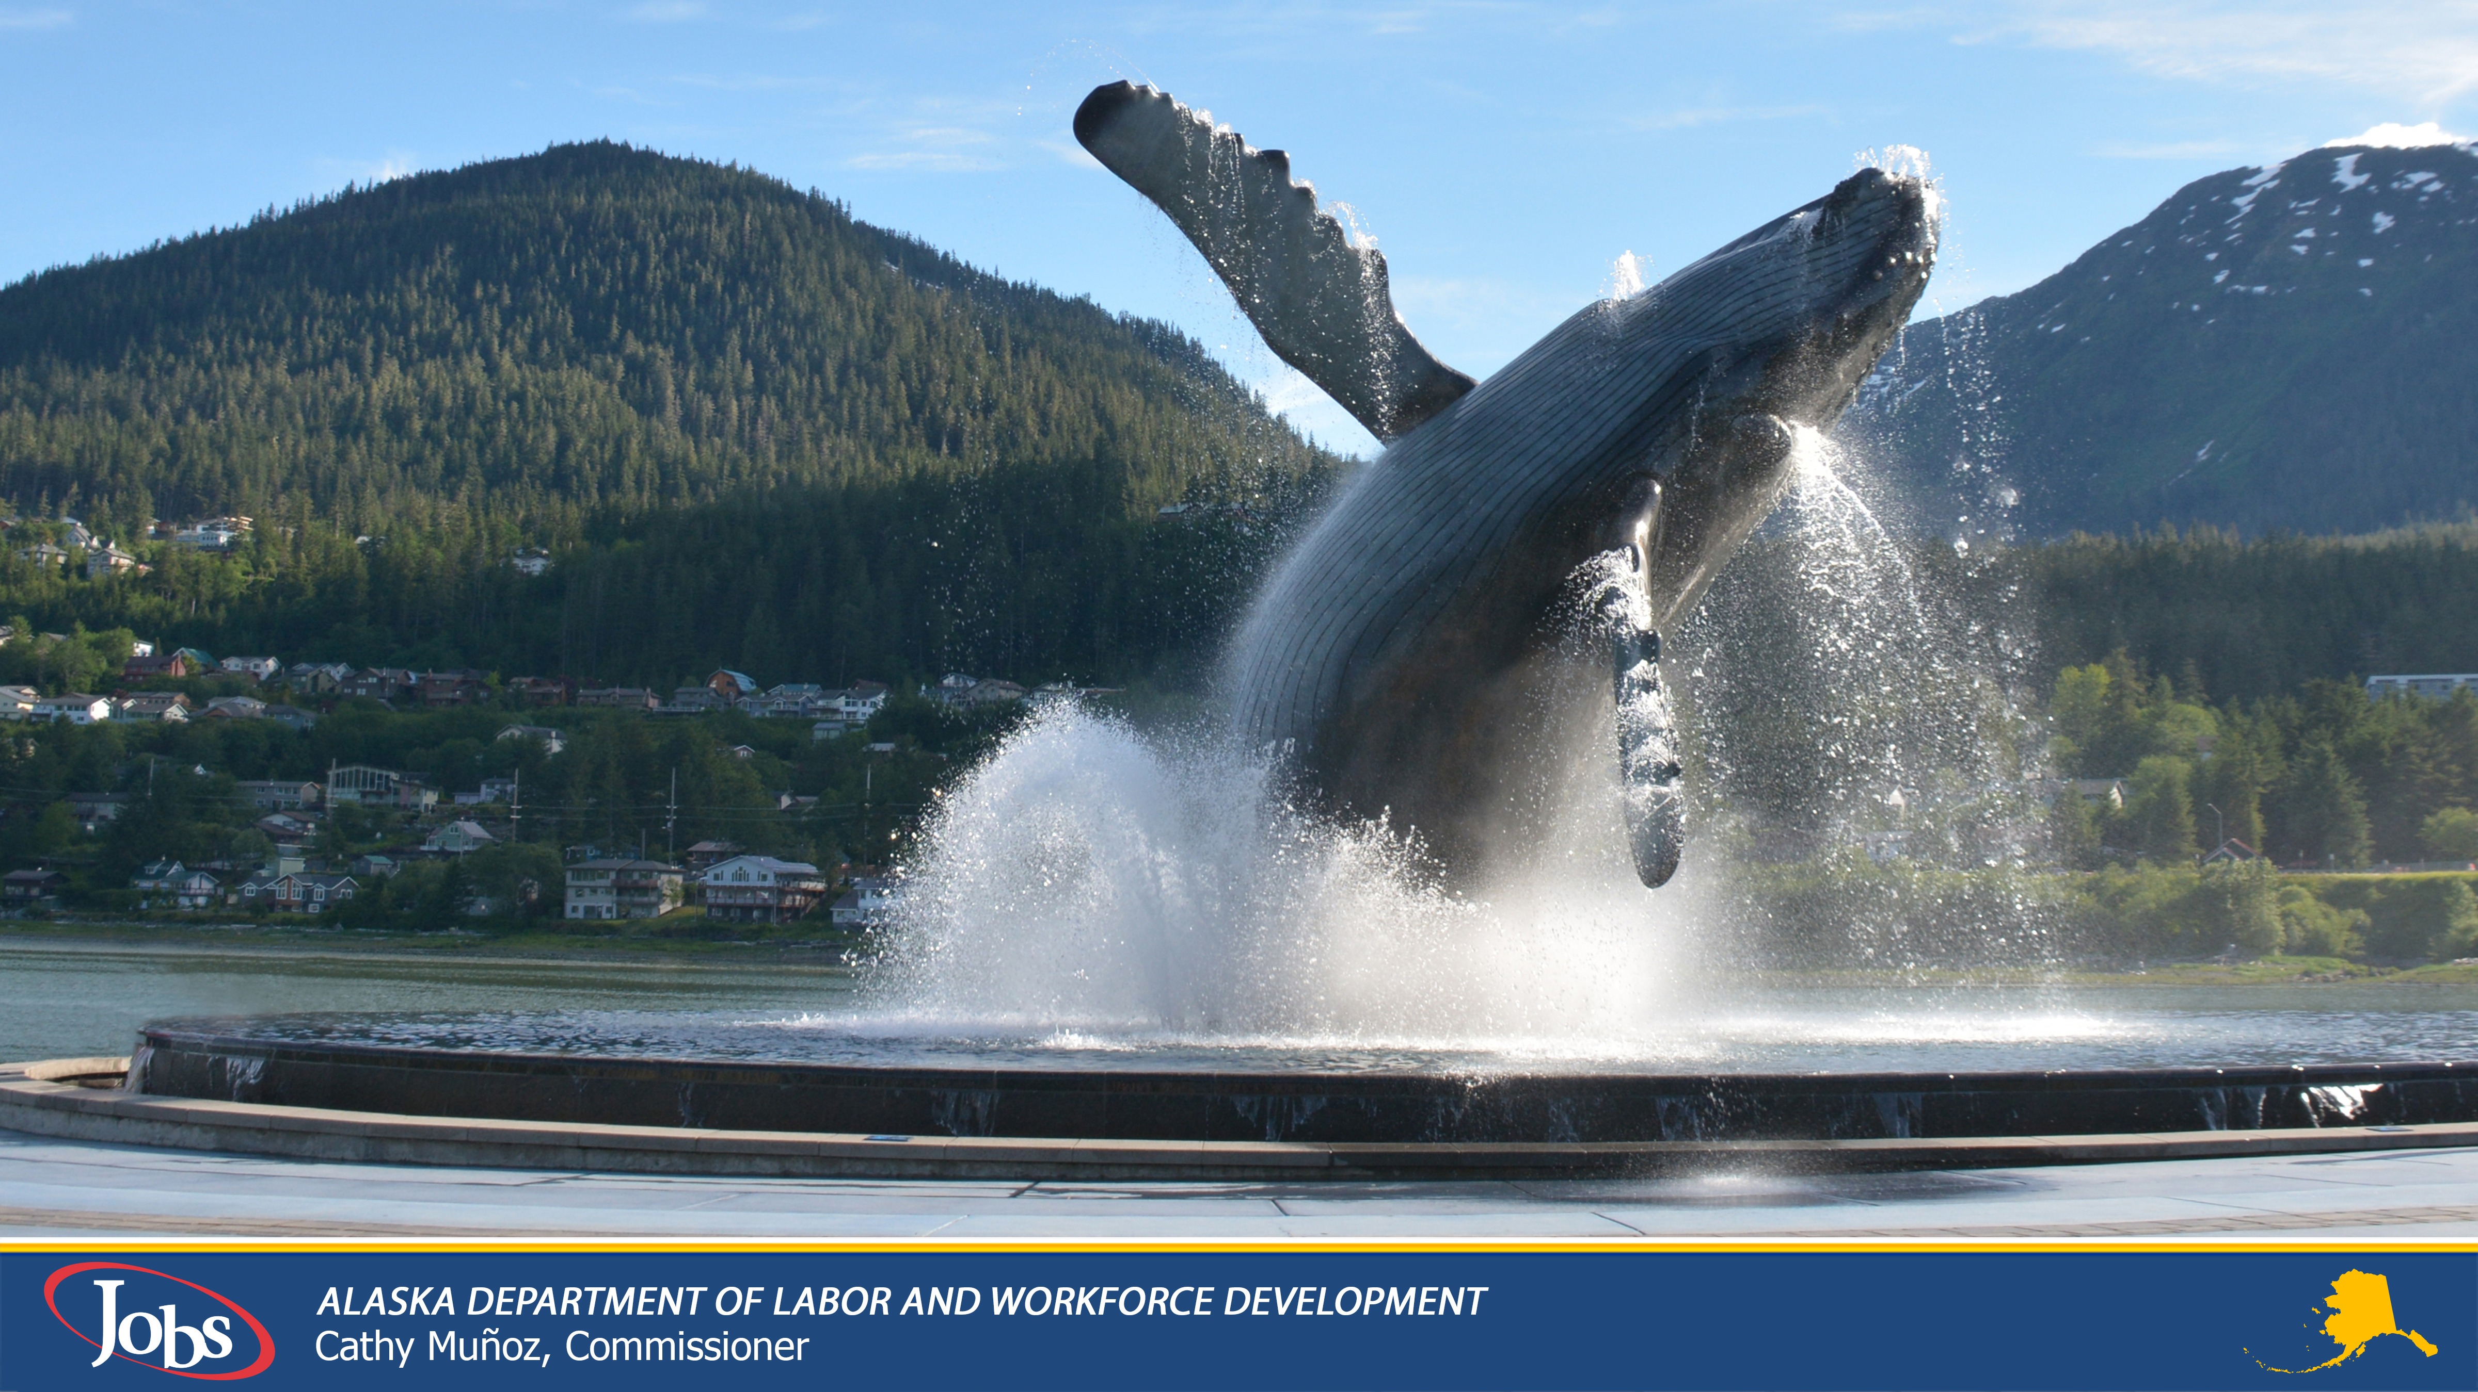

Department of Labor and
Workforce Development
November 14, 2025
Charles Collins – Director Workers’ Compensation

Slide 2


Kids Chance of Alaska
Consider Supporting

Slide 3
What is Workers’ Compensation
A work-related injury, illness or death must arise out of and in the course of employment.
No Fault System
Means the employee does not need to prove their employer was negligent to receive benefits.
Each state has its own workers' compensation laws, which can vary in terms of eligibility, benefit amounts, and claim filing procedures.
The employer is responsible for purchasing workers' compensation insurance and paying premiums to the insurance company.
The American workers’ compensation system is distinguishable from public social insurance in its essentially private nature, in the question of qualification for and measure of benefits, in the allocation of the burden of payment, in its retention of some relation between hazard and liability, and in its mechanism of unilateral employer liability. (Larson’s)

Slide 4
History of Workers’ Compensation
One of the earliest examples of a workers’ compensation system dates back to 2050 B.C. A law in Ancient Sumeria paid workers for their injuries. Similar laws were in place in Ancient Greece, China and other parts of the world. For example, under Ancient Arab law, if an injured worker hurt their ear, they got an amount of money based on surface area injured.
Early US workers' compensation laws
1906 and 1908: The Federal Employers' Liability Acts (FELA) were passed to provide benefits for railroad workers who proved negligence
1911: Wisconsin became the first state to pass a workers' compensation law, which provided compensation regardless of fault
Workers’ compensation insurance is the oldest social insurance program in the United States; in fact, it is older than both social security and unemployment compensation.

Slide 5
Why Workers’ Compensation
Unholy Trinity of Defenses
Contributory negligence meant an employer wasn’t at fault if the worker was in any way responsible for their injury.
“Fellow Servant” Doctrine prevented employers from being held liable if another worker caused an employee’s injury.
Assumption of risk was a doctrine that stated employees knew and accepted the risks involved with their work when signing a job application.
Because of these laws, workers rarely received any compensation when injured.

Slide 6
Alaska Workers’ Compensation
Workers’ Compensation was first introduced in the Alaska territory in 1913. Known then as workmen’s protection.
Alaska's workers' compensation system began in 1959 with the Statehood Act. The system has changed over time to protect injured workers while also considering the costs of insurance.
The first laws were created in 1960 to protect workers and employers
In the late 1960s and 1970s, compensation and disability rates were adjusted as the economy grew
In the 1980s, changes were made to focus on disability costs
In 2000, the Act was updated to change how permanent impairments were compensated
In 2005, job dislocation benefits and the Benefits Guaranty Fund were established
In 2025, Stay-at-Work / Return-to-Work benefits were added

Slide 7
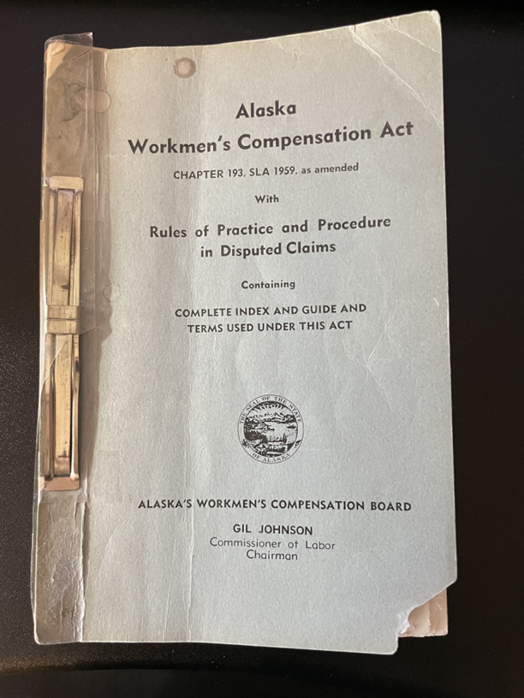
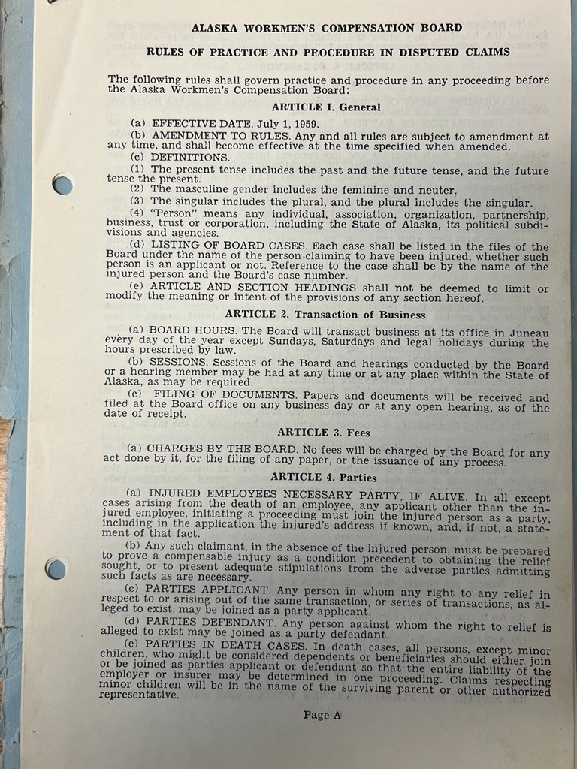
Alaska Workers’ Compensation
No Regs
Commissioner Johnson served 1960 to 1966
Notes:
Articles not regulations.

Slide 8
Alaska Workers’ Compensation
Alaska Statute 23.30.001. Legislative Intent.
It is the intent of the legislature that
(1) this chapter be interpreted so as to ensure the quick, efficient, fair, and predictable delivery of indemnity and medical benefits to injured workers at a reasonable cost to the employers who are subject to the provisions of this chapter;
(2) workers' compensation cases shall be decided on their merits except where otherwise provided by statute;
(3) this chapter may not be construed by the courts in favor of a party;
(4) hearings in workers' compensation cases shall be impartial and fair to all parties and that all parties shall be afforded due process and an opportunity to be heard and for their arguments and evidence to be fairly considered.
Notes:
Added 2005

Slide 9
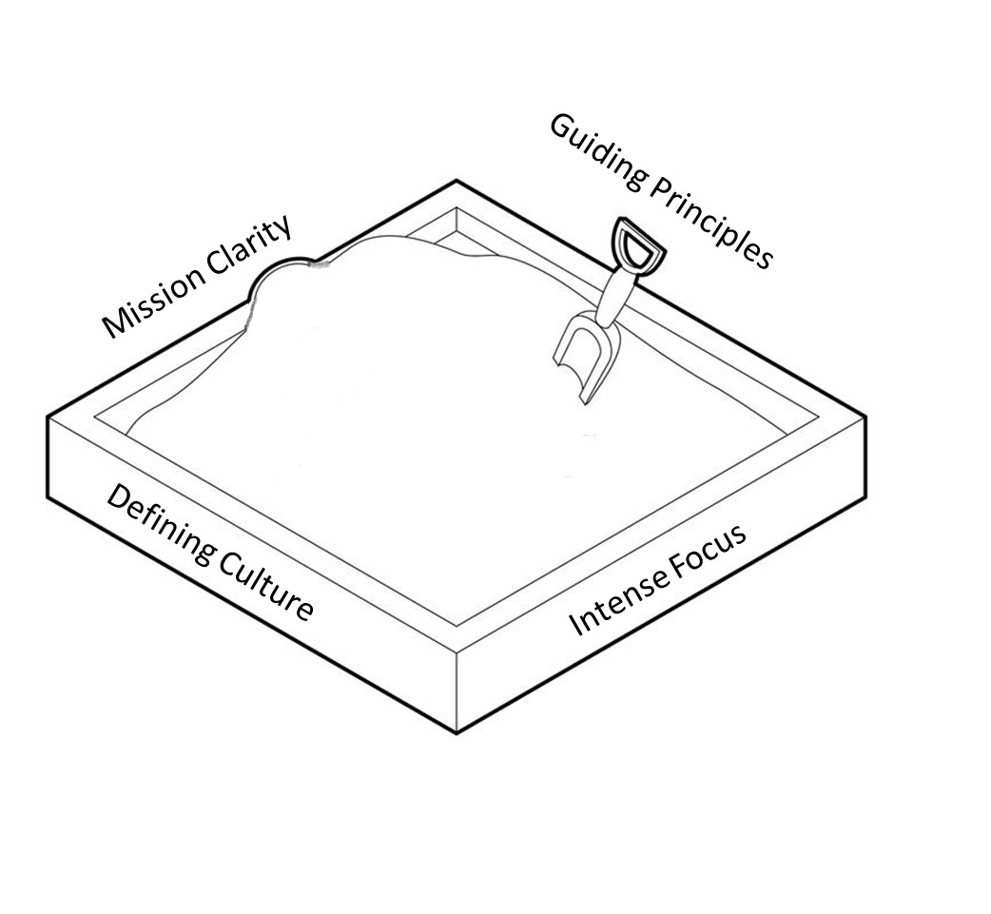
Alaska Workers’ Compensation
to ensure the quick, efficient, fair, and predictable delivery of indemnity and medical benefits to injured workers at a reasonable cost to the employers

Slide 10
Workers’ Compensation Division
Protect Workers
Charles Collins, Director
Administration:
Log almost 20,000 reports of injury annually
Track $250m in benefits and services
Compile and store data from over 60 years of claims
Adjudication:
Reemployment:
Orders eligibility evaluations
Investigation:
Investigate and educate employers
Workers’ Compensation Benefits Guaranty
Provide for medical and indemnity benefits for injured uninsured workers
Fisherman’s Fund
Manage and reimburse commercial fisherman’s injury claims
Self-Insurance Program
Ensure the self-insured entity meets statutory financial criteria
Mediate agreements between parties
Hold thousands of informal meetings for expediency of claims
Approves reemployment plans
Monitors rehabilitation specialists
Follow up on fraud claims
Collaborate with other investigative units to keep Alaska workers safe
Actively manage the “Fisherman’s Fund”
Manage the claims database
Process payments on judgements from uninsured employers
Actively manage the Benefits Guaranty Fund
Perform annual audits on each organization
Collects proper collateral as prescribed by statute
Publish decisions of formal hearings
Coordinate SAW/RTW benefits

Slide 11

Alaska Workers’ Compensation Board
Established under AS 23.30.005
Made up of 18 members
9 represent Industry
9 represent Labor
Broke up into Panels, one from First Judicial District, two from the Second and Forth Judicial District and Five from the Third Judicial District. One Panel is detailed at large and can represent any Judicial District.
Panels are normally three members, two Board members and a designated hearing officer.
The AWCB also is responsible for regulations under The Act.
The AWCB has oversite on two committees that annually meet:
Medical Services Review Committee
Second Independent Medical Evaluation committee

Slide 12
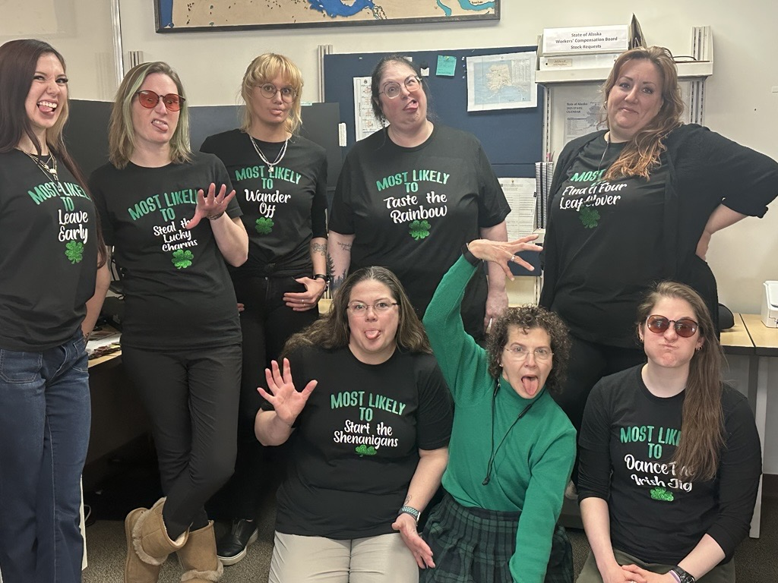
Alaska Workers’ Compensation
Our professional and highly educated staff are eager to assist parties.

Slide 13
How Does it Work
Injury Occurs
Benefits paid
Denied / Controverted benefits (then what)
Employer / Insurer notification
Fill out and File a Report of Injury (FROI)
Seek medical care!
The Basics
Notes:
FROI within 10 days.

Slide 14
Benefits Under Workers’ Compensation
Medical Benefits - The employer shall furnish medical, surgical, and other attendance or treatment, nurse and hospital service, medicine, crutches, and apparatus for the period which the nature of the injury or the process of recovery requires, not exceeding two years from and after the date of injury to the employee.
Reemployment Benefits – Retraining, relocation, job accommodation, and job search benefits.
Death Benefits – Funeral Expenses and Widow/Widower and/or dependents support benefits.
Indemnity – Permanent total disability, permanent partial impairment, temporary total disability, and temporary partial disability.
Legal – All attorney fees*, discovery costs, and legal fees.
Notes:
Employer pays.

Slide 15
Adjudication Process
Benefits are Denied or Controverted
Claim File
AWCB serves ER/ADJ
Accepted Claim
PHC set
Resolution
Employee
EE
Petition File
ER/ADJ Attorney Serves EE
Accepted Claim
PHC set
Resolution
Employer
ER
Adjustor
ADJ

Slide 16
Adjudication Process
No Resolution and Benefits are Denied or Controverted
PHC on Rights
Discovery
Employer Medical Evaluation
PHC on Medical Dispute
SIME
PHC on Issues for Hearing
Mediation
Formal Hearing
Decision and Order
Notes:
Where the fun begins.

Slide 17
By The Way
AWCB Decision
WC Appeals Commission
Alaska Supreme Court
Appeals

Slide 18
Reports of Injury in Relation to Adjudication

Slide 19
Legal Costs in Alaska
Adjudications
The Alaska Workers’ Compensation Board
The board held or processed the following in 2024.
Held
Prehearings:1,846 compared to 1,204, in 2023 and 1,187 in 2022.
Hearings: 172 compared to 123 in 2023 and 99 in 2022.
Mediations: 55 compared to 68 in 2023 and 69 in 2022.
Compromise & Release Agreements – Totaled 408
  Board approved 375 compared to 417 in 2023 and 344 in 2022.
  Board denied 33 compared to 39 in 2023 and 43 in 2022.
Issued
  79 Decision & Order Decisions, compared to 84 in 2023 and 76 in 2022.
The Alaska Workers’ Compensation Appeals Commission
The Commission hearing data for 2024.
Hearings
The Commission held 3 hearings, compared to 2 in 2023 and 8 in 2022.
Oral Arguments on the Merit of Appeals
The Commission held three oral arguments, compared to 1 in 2023.
Motion For Stays of Board Orders
The Commission held zero hearings on a motion for stay.

Slide 20
Legal Costs in Alaska

Slide 21
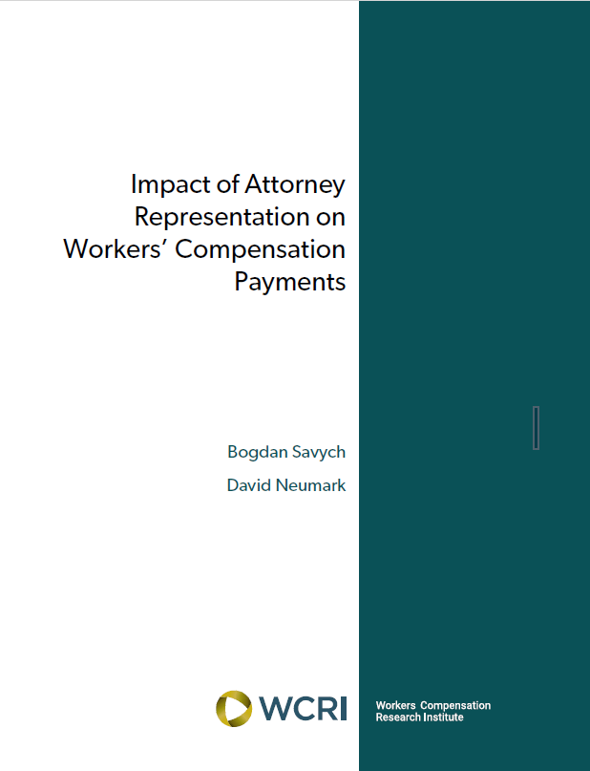
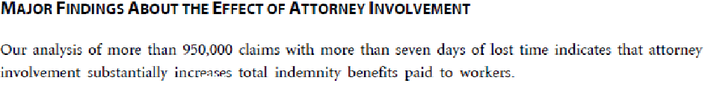
Legal Costs in Alaska

Slide 22
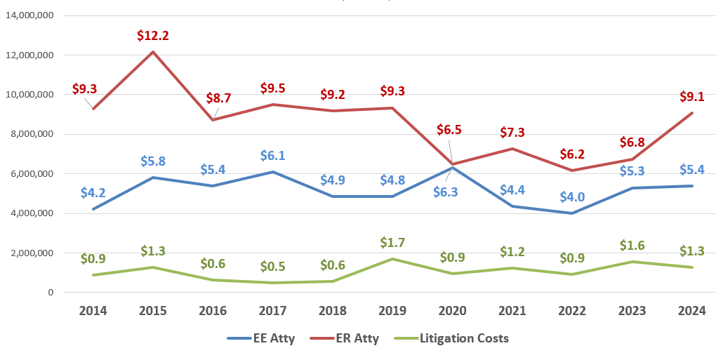
Legal Costs in Alaska
Legal Benefit Payments
Total legal costs were $15.7 million in 2024 compared to $13.6 million in 2023, and $11.1 million in 2022.
Legal cost represented 7% of total compensation costs.
Legal Costs - 2024 | Payment Amount | % of Total Legal
Employee Attorney | $5,374,125 | 34.2%
Employer Attorney | $9,069,477 | 57.8%
Litigation | $1,255,722 | 8%
Total | $15,699,324

Slide 23
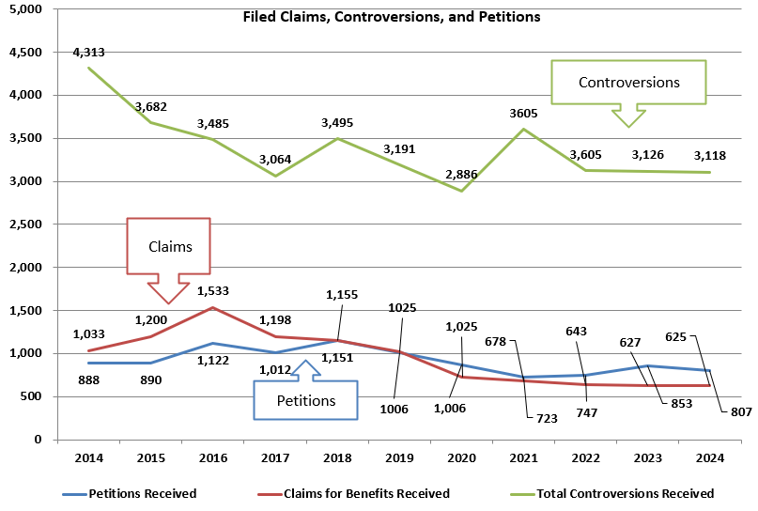
Legal Costs in Alaska
Analysis of Workers’ Compensation Claims Data
Filed Claims, Controversions, and Petitions
In 2024, there were 625 claims for benefits filed, a 0.3% decrease from 627 claims filed in 2023.
591 cases of which 136 cases had more than one filing.
34 cases were withdrawn.
There were 807 petitions filed in 2024, a 5.4% decrease from 853 petitions filed in 2023.
765 cases of which 323 cases had more than one filing.
42 cases reflected withdrawn petitions of which 4 cases had more than one filing.
There were 3,105 total controversions received in 2024, a 0.4% decrease from 3,118 in 2023.
2,860 cases of which 711 cases had more than one filing.
245 cases reflected withdrawn controversions of which 14 cases had more than one filing.

Slide 24
Workers’ Compensation Numbers
Notes:
All medical, all indemnity, all litigation, and all premiums.

Slide 25
What does Workers’ Compensation Cost
Notes:
National Academy of Social Insurance.

Slide 26
Legislation in Process
Legislative Designation | Title | Location | Details
HB 44 | Death Benefits | House Labor & Commerce | Increases benefit to $120k
HB 88 | Tuition | House Education | Free tuition for EE or Dep
HB 103 | Fire Fighter Disability | House Labor & Commerce | Shortens years of service
HB 179 | Notice for State Actions | House State Affairs | Allows for Electronic Notice
HB 193 | Paid Parental Leave Act | House Finance | Claims to be paid like UI
SB 35 | Network Delivery Drivers | Senate Labor & Commerce | Uber Eats Bill
HB 148 / SB 132 | Insurance Omnibus | Signed into Law | Effects WC slightly
HB 149 / SB 134 | PBM Administration | Senate Rules | Adds PBM’s to audit list.
Notes:
HB 44 Death Benefit to estate $120,000. Had hearing.
HB 88 offers free tuition to injured EE or dependent at state supported, limited to first responder/military. No movement.
HB 103 Shortens the time a firefighter must have worked before presumption attaches and sets a bi annual exam frequency. No hearing.
HB 179 Changes requirements for notice, allows for electronic. No action.
HB 193 Sets up dedicated fund, claims to be added to WCD workload. Several Hearings and work between sessions.
SB 35 In response to WC being required by delivery drivers vs transportation drivers. Lots of hearings.
HB 149 In House Health, SB 134 advancing faster, slightly effects WC.

Slide 27
Possible Legislation
Amendments to AS 21.09.210(1) | Raise the 2.7 percent (fee) to 4%
Amendments to AS 23.05.067(a)(1)(B) | Raise the 2.9 percent to 4%
Amend AS 23.30.110(c) and (e) | Remove registered / certified mail references. Digital Service of documents.
Amendments to AS 23.30.080 | Requirement for employer to produce payroll records and a penalty for refusal.
Amendments to Section 21 | Insurance database requirements

Slide 28

Regulatory
Administrative Order 360
This Order is issued to achieve the following goals:
  Promote growth and investment in Alaska by reducing administrative and economic burdens associated with regulatory compliance, including removing barriers, finding solutions, and identifying alternative pathways.
  Streamline permitting processes and improve coordination and efficiency within all permitting departments, including the Department of Natural Resources (“DNR”), the Department of Environmental Conservation (“DEC”), and the Department of Fish and Game (“DFG”).
  Ensure boards and commissions adjust regulatory structures as necessary to maintain critical consumer protection while eliminating unnecessary barriers to entry for new professionals.
  Engage stakeholders early and continuously in the regulatory development and reform process.
  Ensure all regulations are clearly written, legally sound, and supported by a demonstrated need.
  Regularly evaluate existing regulations for effectiveness, redundancy, clarity, and impact.
  Reduce the regulatory burden on all Alaskans.

Slide 29
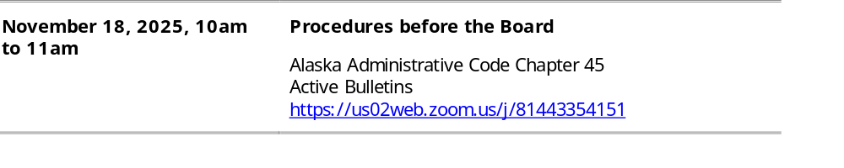
Regulatory
Solicitation for Public Input – Workers’ Compensation Regulatory Revisions
Notice of Public Scoping Under Administrative Order 360 for possible Department of Labor and Workforce Development, Division of Workers’ Compensation Regulation Changes.
8 AAC 45.020 – 8 AAC 45.120 8 AAC 45.150 – 8 AAC 45.170 8 AAC 45.178
8 AAC 45.180 8 AAC 45.180 8 AAC 45.182 8 AAC 45.195

Slide 30
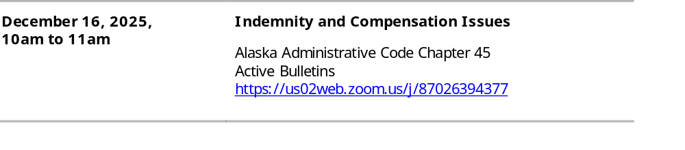
Regulatory
Solicitation for Public Input – Workers’ Compensation Regulatory Revisions
Notice of Public Scoping Under Administrative Order 360 for possible Department of Labor and Workforce Development, Division of Workers’ Compensation Regulation Changes.
8 AAC 45.122 – 8 AAC 45.142 8 AAC 45.210 – 8 AAC 45.225

Slide 31
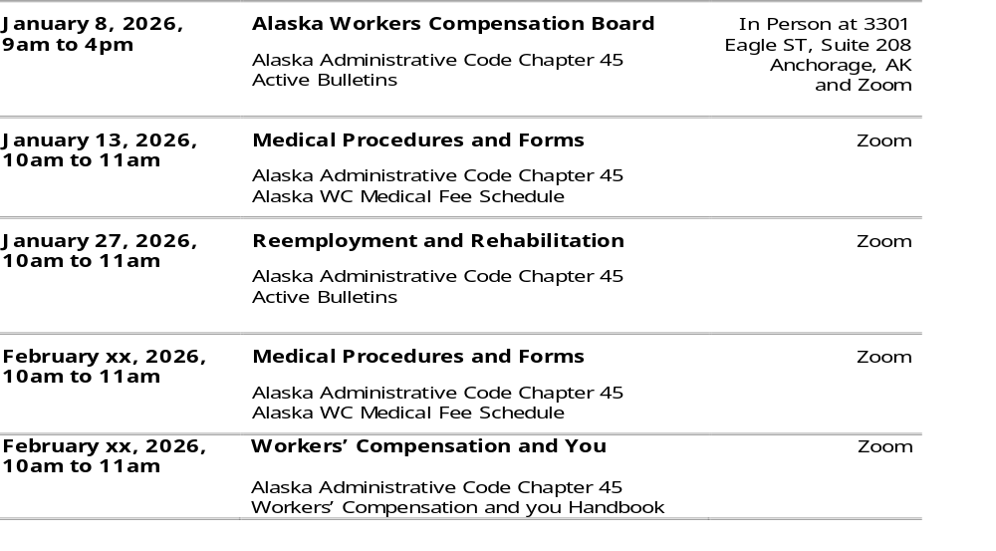
Regulatory
DRAFT

Slide 32
Regulatory
Ideas for Regulation Reduction:
Possible complete Repeal: | Amendments for Consideration:
8 AAC 45.030. Files | 8 AAC 45.081. Dispensing of generic drug products.
8 AAC 45.085. Duty of ER and Insurer to file evidence of insurance. | 8 AAC 45.082. Medical treatment.
8 AAC 45.130. Findings and awards and orders. | 8 AAC 45.083. Fees for medical treatment and services.
8 AAC 45.132. Survival of accrued benefits. | 8 AAC 45.084. Medical travel expenses.
8 AAC 45.142. Interest. | 8 AAC 45.090. Additional examination.
8 AAC 45.170. Listing of injuries. | 8 AAC 45.210. Weekly compensation rate.

Slide 33
Regulatory
For example:
8 AAC 45.060. Service. (a) The board will serve a copy of the claim by certified mail, return receipt requested, upon each party or the party's representative of record.
8 AAC 45.900. Definitions.
(j) For an injury occurring after December 22, 2011, "previously rehabilitated" under AS 23.30.041(f)(3) means having (1) completed a reemployment benefits plan under AS 23.30.041 or a substantially similar law in another jurisdiction; or (2) done both of the following: (A) having stipulated to eligibility, having an eligibility request approved, or having an eligibility evaluation ordered under AS 23.30.041(c); (B) having waived reemployment benefits under AS 23.30.041(q), 23.30.012, or a substantially similar law in another jurisdiction.

Slide 34
Regulatory
My Favorite:
8 AAC 45.210. Weekly compensation rate. (a) The weekly rate of compensation is based on a seven-day week. When computing compensation for a number of days not equally divisible by seven, the result will be carried to three decimals. (b) Until an employee provides the information requested on the green copy of form 07-6101 and submits it in accordance with the form's instructions, compensation is due based on the assumption that the employee is legally entitled to claim the marital status of "single" and himself or herself as a dependent.

Slide 35
Nationwide Workers’ Compensation Concerns 2025
The aging workforce: rising claims and new approaches.
  October 2025 Alaska Economic Trends.
2. Mental health: expanding coverage and early intervention.
  Several states are expanding workers’ compensation coverage for mental health conditions, particularly for first responders.
3. Exclusive remedy: legal challenges and risk implications.
  Recent court cases in California, Kentucky, Mississippi and Nebraska have tested the boundaries of this legal protection.
4. Medical treatment access: workforce shortages and system resilience.
  Access to medical care remains a critical issue in workers’ compensation. The Association of American Medical Colleges projects a shortage of up to 86,000 physicians by 2036, driven by retirements, increased demand and limited growth in residency programs.
Notes:
Max Koonce, Sedgwick

Slide 36
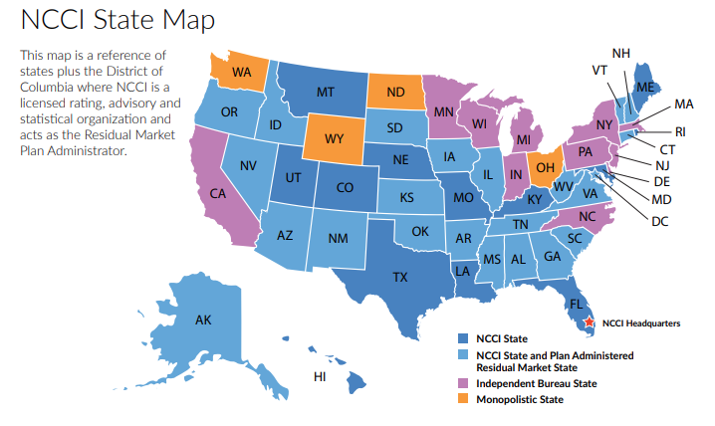
Alaska Workers’ Compensation

Slide 37
NCCI
NCCI's Classification Inspection Program
NCCI conducts a Classification Inspection Program in all NCCI states as a part of its ongoing core services. NCCI’s Classification Inspection Program monitors the accurate and consistent application of the rules and classification system by:
providing inspections of current classification code utilization, which ensures that the classification of selected insureds' current business operations conforms with NCCI manual rules and classifications
providing feedback to employers, carriers, and regulators on inspection results
providing support of classification filings made on behalf of NCCI affiliates for state regulatory approval, and
validating the classification system, which may be affected by a continually changing business environment and NCCI item filings.

Slide 38
NCCI’s Residual Market Management Summary 2024
NCCI provides plan or pool services, including both reinsurance pools and direct assignment experience for 27 states.
Combined insurer financial call data reported in 2024 was $29.8 billion.
NCCI monitored 3.7 million policies which had 3.2 million claims in 2024.
There were about 53.1 million medical data call transactions in 2024.
The residual market loss reserves is $3.8 billion.
Courtesy of NCCI, Residual Market Management Summary 2024

Slide 39
Investigations Fraud Hotline and Email Tips
ACTIVITY | FY2025
Pending Cases Carried Forward | 175
New Cases Opened | 424
Cases Closed | 465
Total Cases Worked | 599
Petitions | 98
Pre-Hearings Attended | 139
Compliance Checks | 426 (online 6150)
Public Inquiries | 363
Formal Hearings | 6
Warning Letters | 63
Investigation Only | 277
Settlements Paid in Full | 78
Settlements with Payment Plans | 21
Percentage Closed in 6 Months | 81% (378 of 465)
Total Penalties | $915,655.51
Total Discounts | $145,549.90
Total Suspensions | $159,576.42
Total Payable | $610,529.19
Uninsured Injuries | 30
Interagency Referrals | 37
 | FY2025
Total Fraud Tip Calls and Emails | 126
Claimant/Injured Worker Tips | 15
Employer Tips | 26
Care Providers | 3
Attorneys/Non-Attorney Reps | 0
Insurance Companies/Agents | 0
Fish Fund Claimants | 0
Law Enforcement Agency Assist Requests | 81
Other/Non-Related | 0

Slide 40
2024 Failure to Insure Investigations

Slide 41
Stay-at-Work Program
Stay-at-Work Coordinator
Injured Worker
Medical Provider
Rehabilitation Specialist
Employer
Leadership Commitment
  SB147
Policy Development
  Regulation Package
Dedicated Personnel
  The nerve center of success
Open Communication
  Open and honest communication
Reasonable Accommodations
  Modified schedules, job duties, and workstations
Transitional Work Options
  Cross-training and upskilling
Healthcare Provider Collaboration
  Establishing strong relationships to ensure clear communications
Without the Stay-at-Work Coordinator position to foster communication and collaboration an impasse is reached.
Benefit:
Reduced absenteeism and employee turnover, Improved employee morale and engagement, Lower workers' compensation costs, and Increased productivity and retention of skilled employees.

Slide 42
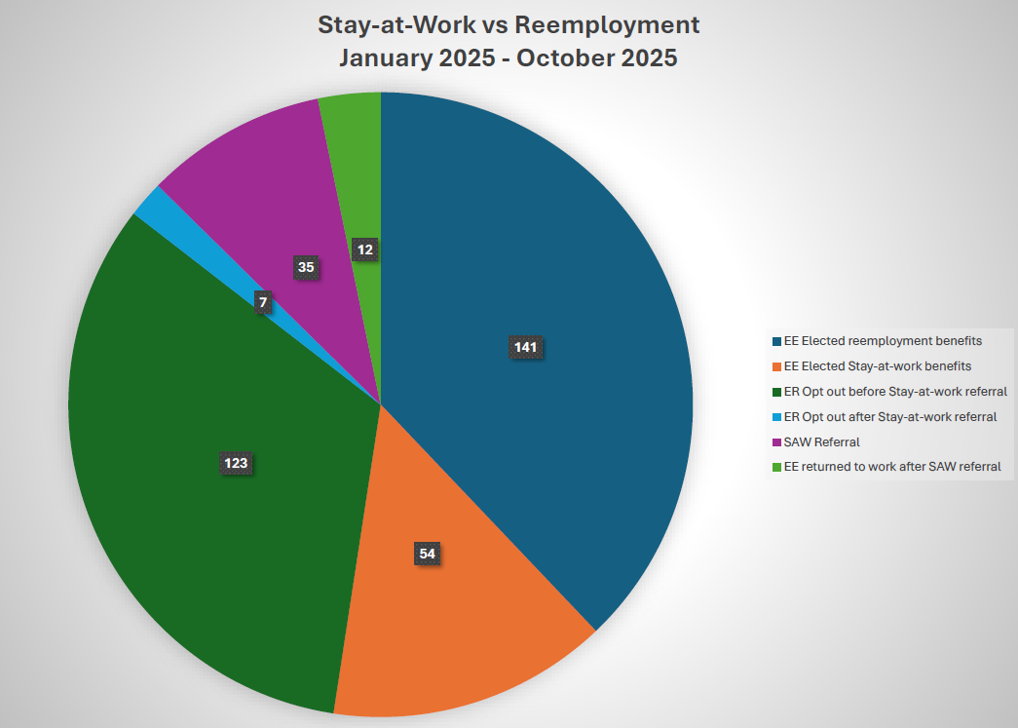
Alaska Workers’ Compensation
574 employer notices that employees injured on or after January 1, 2025

Slide 43
Designated General Funds Within Workers’ Compensation
Second Injury Fund – Dedicated fund for the purpose of reimbursing compensation payments made by employers, or their insurers or adjusters, to certain injured employees. Sunset for claims August 2018.
Fishermen’s Fund – Established in 1951, the Fishermen's Fund provides for the treatment and care of Alaska licensed commercial fishermen who have been injured while fishing on shore or offshore in Alaska.
Benefit Guaranty Fund – Established by the Alaska Legislature in 2005 and is applicable to injuries occurring on or after November 7, 2005. The Fund was created to assist injured workers who were injured while working for an uninsured employer, i.e., an employer who failed to have workers’ compensation insurance on the date of injury. The Fund’s revenue comes from civil penalties assessed against uninsured employers.
Workers’ Safety and Compensation Administration Account – Dedicated fund for the purpose of administration of the workers’ safety programs contained in AS 18.60 and of the Alaska Workers Compensation Act contained in AS 23.30.

Slide 44
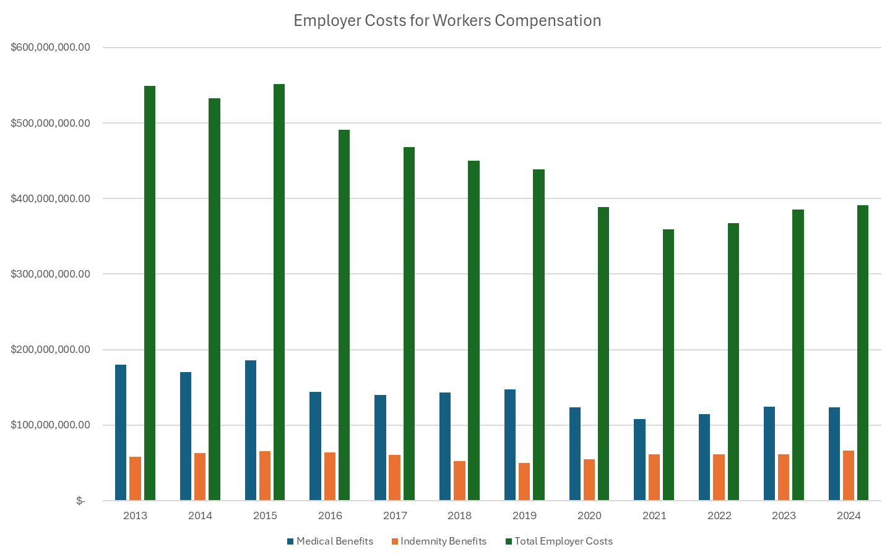
Total Costs in Alaska

Slide 45
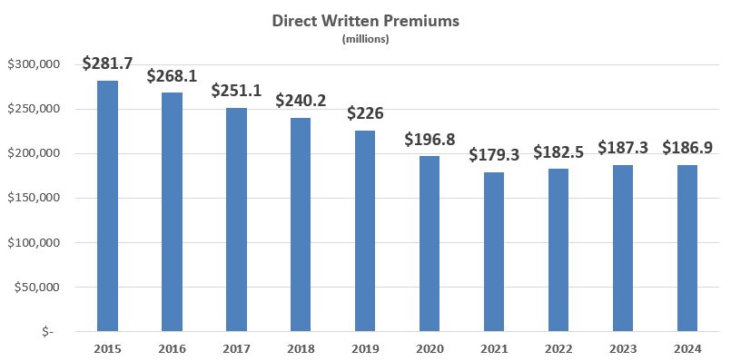
Direct Written Premiums
Calendar Year | Direct Written Premiums * (000s)
2024 | $186,914
2023 | $187,269
2022 | $182,521
2021 | $179,252
2020 | $196,813
2019 | $225,954
2018 | $240,150
2017 | $251,110
2016 | $268,052
2015 | $281,738

Slide 46
Workers’ Safety and Compensation Administration Account

Slide 47
Workers’ Compensation Budget
Workers Safety and Compensation Administration Account (WSCAA)
 | FY23 | FY24 | FY25 | FY26 | FY27 | FY28
Leg Allocation from WSCAA | $ 7,266,100.00 | $ 7,418,900.00 | $ 7,907,700.00 | $ 8,032,600.00
WSCAA Revenue | $ 6,507,298.10 | $ 6,722,658.41 | $ 6,651,844.62 | $ 6,632,190.76 | $ 6,673,821.65 | $ 6,657,542.73
Empty Authority | $ 758,801.90 | $ 696,241.59 | $ 1,255,855.38 | $ 1,400,409.24
Workers' Comp | $ 5,647,669.82 | $ 5,679,967.68 | $ 5,573,382.20 | $ 6,560,115.94 | $ 6,599,476.64 | $ 6,639,073.50
WC Appeals Commission | $ 391,564.18 | $ 373,796.46 | $ 371,610.22 | $ 383,944.93 | $ 386,248.60 | $ 388,566.09
WC Capital Improvement Project | $ - | $ - | $ - | $ - | $ - | $ -
Occupational Safety and Health | $ 157,410.18 | $ 226,803.12 | $ 584,931.14 | $ 569,396.00 | $ 572,812.38 | $ 576,249.25
Labor Market Info | $ 83,603.79 | $ 69,946.26 | $ 75,711.07 | $ 67,402.00 | $ 67,806.41 | $ 68,213.25
Expenditure Total | $ 6,280,247.97 | $ 6,350,513.52 | $ 6,605,634.63 | $ 7,580,858.87 | $ 7,626,344.02 | $ 7,672,102.09
 |  |  |  | Projection
Revenue Shortfall | $ 227,050.13 | $ 372,144.89 | $ 46,209.99 | $ (948,668.11) | $ (952,522.38) | $ (1,014,559.36)

Slide 48

Alaska Workers’ Compensation
Questions?

Slide 49
Contacts
Cathy Muñoz, Commissioner
Email: Commissioner.Labor@alaska.gov
Phone: (907) 465-2702
Charles Collins, Director
Email: Charles.Collins@alaska.gov
Phone: (907) 465-6060
Janel Wright, Chief of Adjudications
Email: Janel.Wright@alaska.gov
Phone: (907) 269-4980

